Slide 1
Marketing For Components
Saturday 04 November 2006
Chavonne Hoyle, Marketing Specialist
&
Judy Brennan, Leadership Program Developer

Slide 2
Reach Out with a
Chapter Event Marketing Plan

Slide 3
Talking Points
Determine chapter event marketing value proposition
Use existing and new forms of communication
Establish a schedule of communications
Use targeted messaging

Slide 4
What is the value proposition of the event for your chapter?
Attract new members?
Retain and enhance value to existing members?
Education and professional development?
Networking?
Other?
Notes:
Define these at the beginning of your plan
Use this to define your target audience
Use this to craft your marketing message to your audience

Slide 5
Take inventory of your contacts
Who is on your mail/email list?
  Members
  Non-members
Do you need to go outside your list?
  List rental
  List sharing with other groups

Slide 6
How many attendees will constitute a successful event?
Establish a goal for attendance
  % of members you want to attend
  % of non-members you want to attend
Define specific target audiences
  By industry
  By profession
  By level (beginner, intermediate, advanced)
  Other

Slide 7
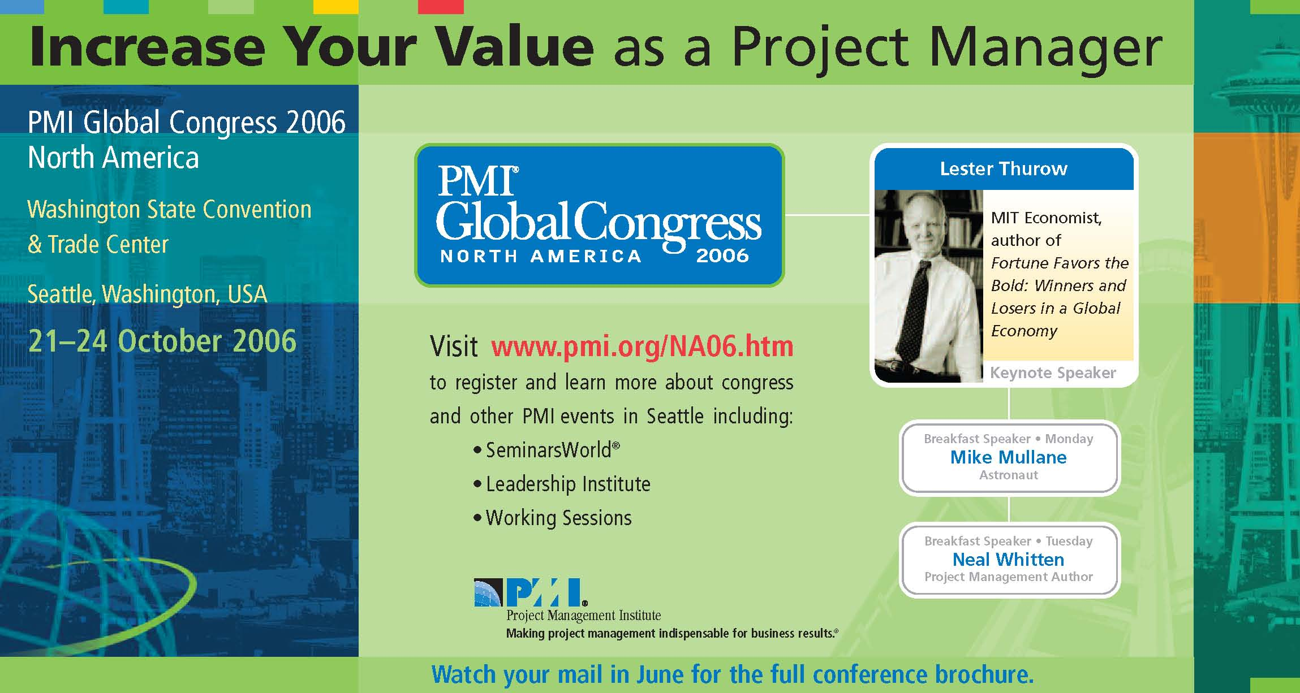
Direct mail targeted at individuals who practice project management

Slide 8
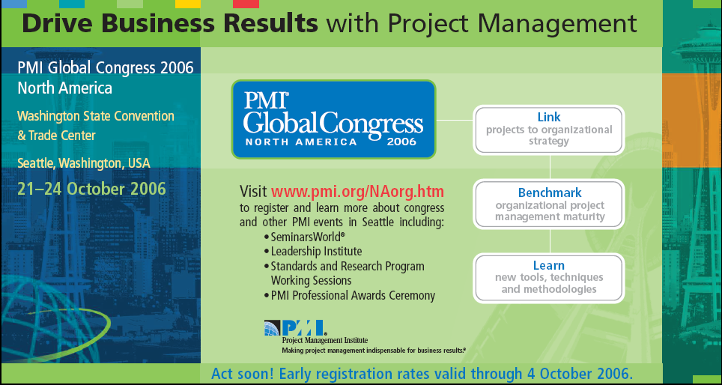
Direct mail targeted at organizations that use project management

Slide 9
Communications available to reach your audience
Website
Direct mail/Email
Advertising
Publications
Other

Slide 10
Website
Create a schedule to keep content fresh
Use web-friendly text – short & punchy
Think about push and pull
Use images to “show” event
Use testimonials from other chapter events

Slide 11
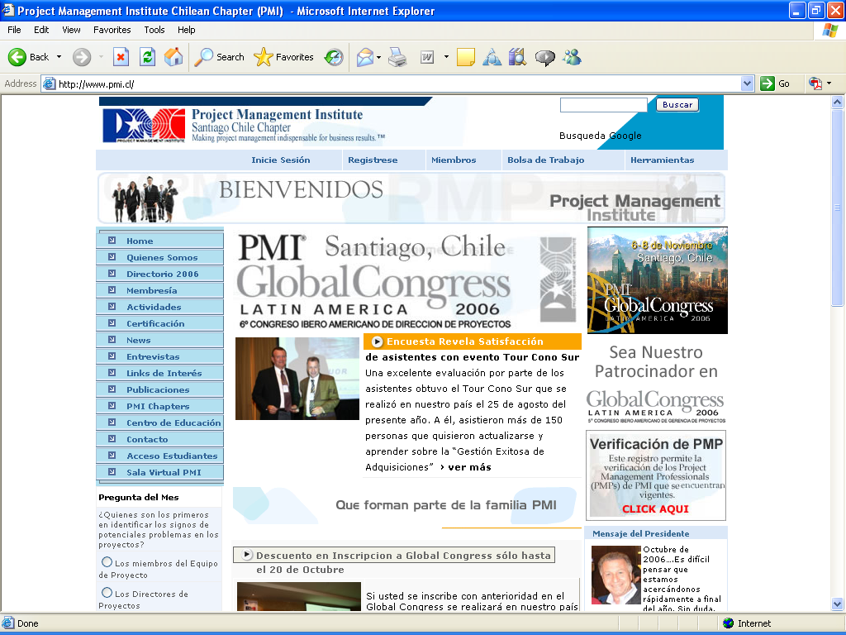

Slide 12
Direct Mail/Email
Try not to over-burden your contacts
What direct mail/email campaigns do you already have in place?
What is your budget for printing and mailing?
  Direct mail = $$$
  Email =$

Slide 13
Publications
Internal
  Chapter newsletter
External
  Industry publications
  Local newspapers
  Local magazines

Slide 14
Advertising
Electronic
  Website ad banners – rotate on targeted sites
  E-newsletter “infomericals”
Print
  Newspapers
  Specialty periodicals – get someone to cover the event
  Event calendar listings – sometimes free

Slide 15
Marketing Timeline
Create a schedule of communications
  How much lead time do you have?
  Decide on frequency to maximize lead time
  Target communications based on placement in cycle
    Early = mark your calendar
    Closer to event = limited seats left, etc.
    First communication is different from last communication

Slide 16
Key messages
Create a mood with words, graphics and images that are evocative of the event
Craft your message with your audience in mind – what are their triggers?
Stagger the information over the campaign – create a storyline
Remember to tell them who, why, where and when
Notes:
Triggers:
PDUs anyone?

Slide 17



Slide 18
Group Exercise
Create an event marketing plan
  What are the goals & objectives of your event?
  Who is your target audience?
  What communication vehicles can you use?
  What is your marketing timeline?
  What are your key messages?

Slide 19
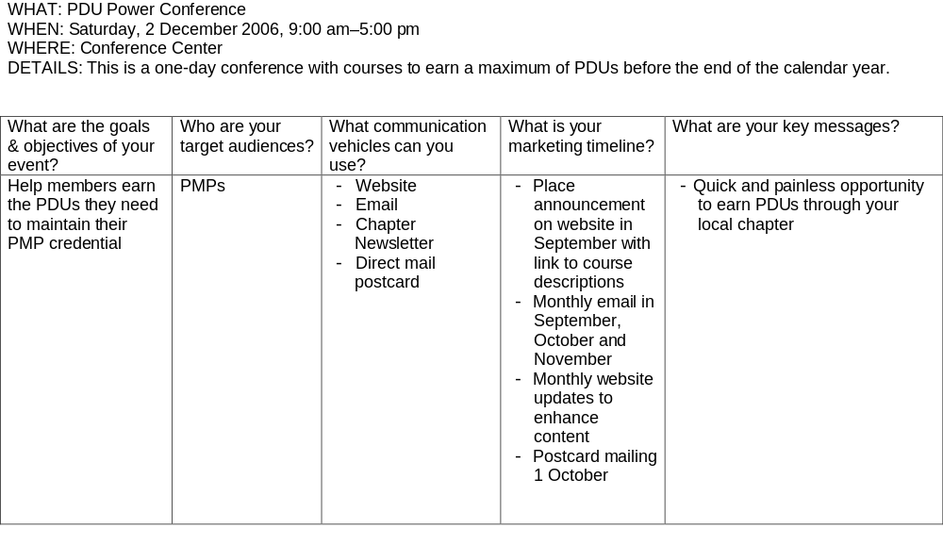
SAMPLE EXERCISE WORKSHEET

Slide 20
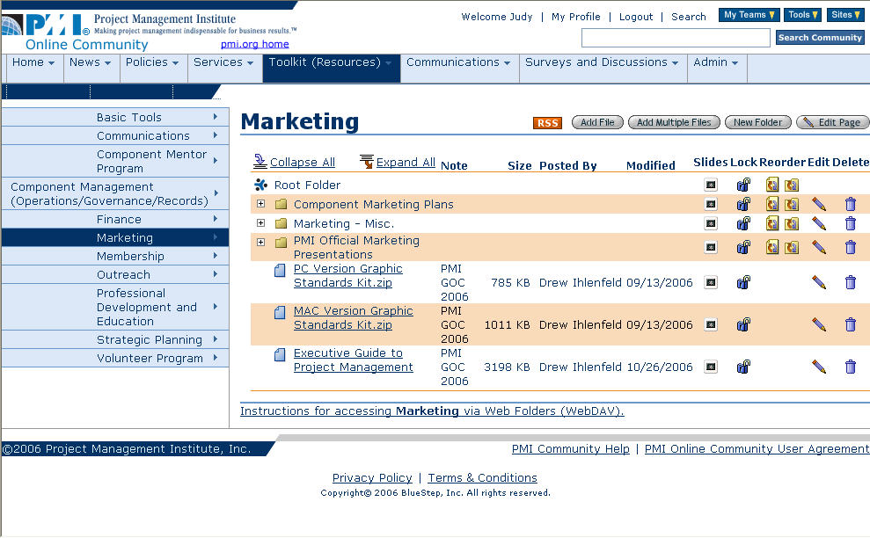
Marketing Resources For Components
Notes:
Available on the Component Leadership Site- http://componentleadership.pmi.bluestep.net/
Contains
Sample marketng plans
PMI official marketing presentations
Graphic Standards Kit
Executive Guide to Project Management

Slide 21
Official PMI Presentations
Making Project Management Indispensible for Business Results
Corporate Presentation
Value of PM
State of PMP
PMI as a Strategic Partner
Notes:
Currently listed on then component leadership site - for your information and use in providing information to your members and business leaders

Slide 22

Notes:
Also availaible is the Executive Guide to Project Management

Slide 23
PMI Graphic Standards Kit
The component’s logo establishes brand identity and visibly identifies the component as an organizationaffiliated with PMI.
PMI GOC has created a “PMI Graphic Standards Kit” for components to utilize to design a component logo that not only uniquely identifies their organization but also aligns them with PMI.
Notes:
Graphic Standards Kit can also be found here- contains guidelines for usage

Slide 24
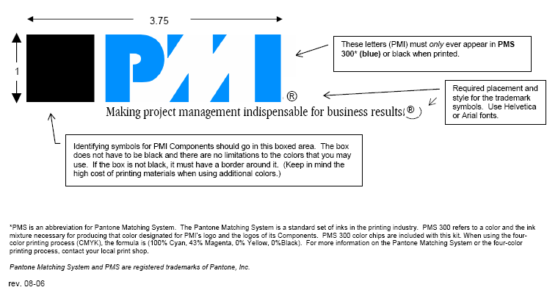
Notes:
When revising or creating your component logo- Graphic Standards Kit –which is available on component leadership site/ toolkit/ marketing.

Slide 25
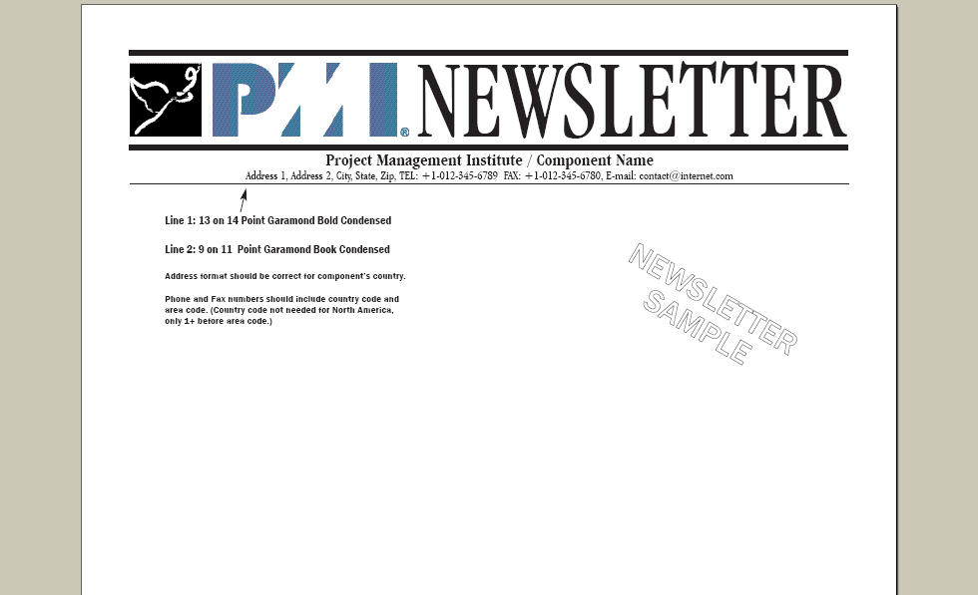
Notes:
Graphic Standards Kit contains sample newsletter layouts, Envelope, letterhead, etc.

Slide 26


Slide 27
Thank You!!
Questions?
Chavonne.hoyle@pmi.org
Judy.brennan@pmi.org

